Slide 1
The Internet of Unpatched Things
Sarthak Grover and Nick Feamster
Princeton University
PrivacyCon ’16

Slide 2
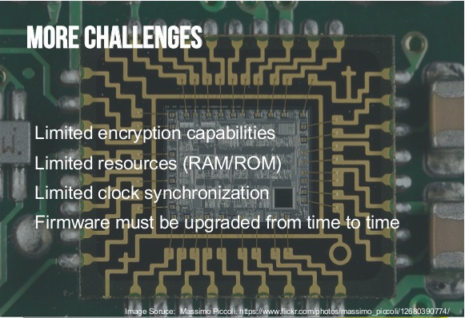
Current State of Consumer Smart Devices
Many different manufacturers, small startups, novice programmers
Low capability hardware, not enough for security protocols
Most data goes to an online server on the cloud
Even devices in the same home communicate via the cloud
forgerock.com

Slide 3



Unpatched IoT Devices Put Our Privacy at Risk
IoT device network traffic:
Leaks user information
Identifies the device being used
May also identify current user activity and behavior!
email:xxx@y.com
URI: smart-light
json:{‘activity’:’switch_on’}

Slide 4
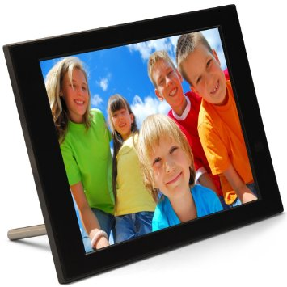
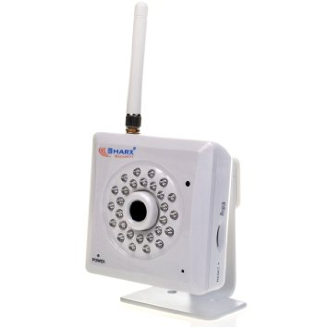
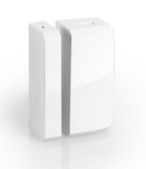
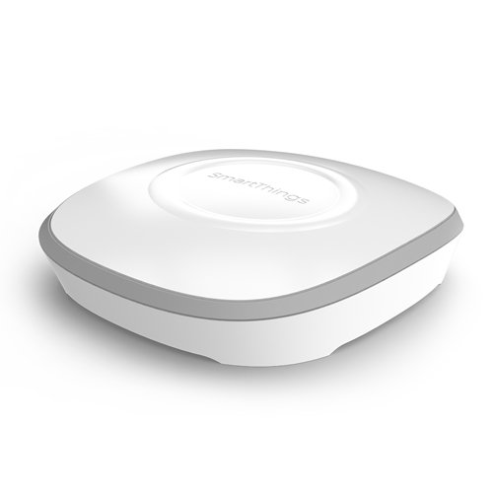
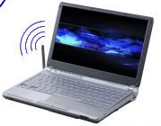
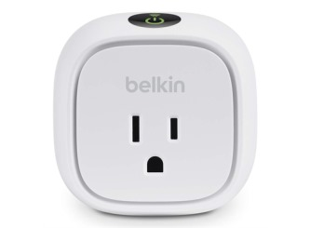
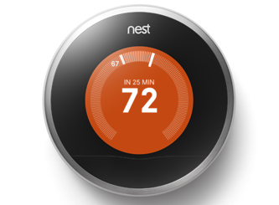
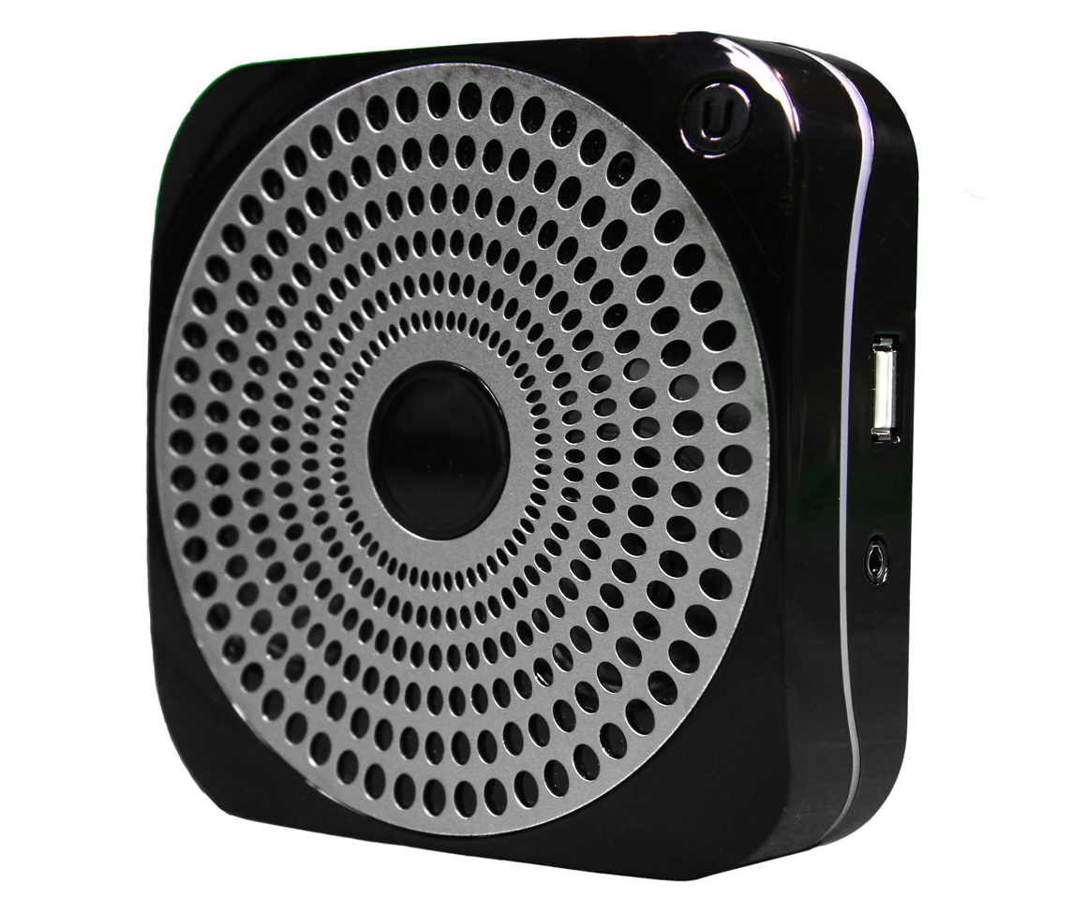
Case Study of Some Common Home IoTs
PixStar Digital Photoframe
Sharx Security IP Camera
SmartSense Multi-sensor
Smartthings Hub
WiFi
Z-Wave
Laptop Gateway (Passive Monitor)
Belkin WeMo Switch
Ubi Smart Speaker
Nest Thermostat
Notes:
We picked top few devices on amazon, tried to pick different manufacturers.

Slide 5
Digital Photoframe: Traffic Analysis
All traffic and feeds (RSS) cleartext over HTTP port 80
All actions sent to server in HTTP GET packet
Downloads radio streams in cleartext over different ports
DNS queries: api.pix-star.com, iptime.pix-star.com

Slide 6
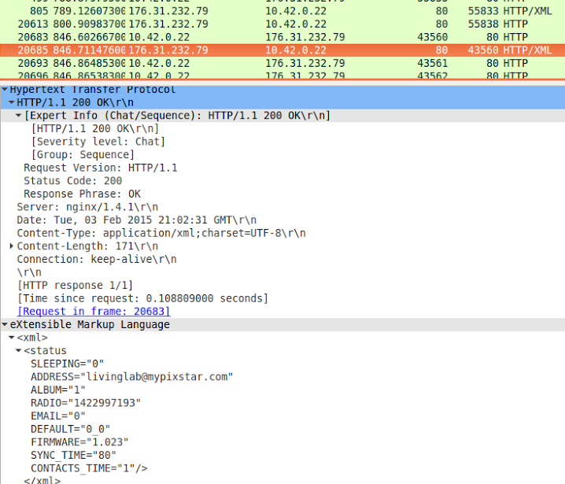
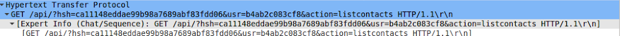
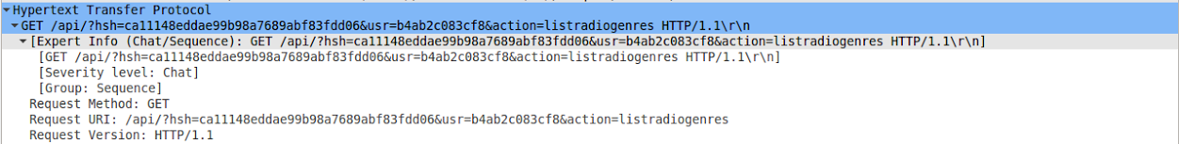
Photoframe: Privacy Issues
User email ID is in clear text when syncing account
Current user activity in clear text in HTTP GET
DNS queries and HTTP traffic identifies a pix-star photoframe
email
current activity

Slide 7
IP Camera: Traffic Analysis
All traffic over cleartext HTTP port 80, even though viewing the stream requires login password
Actions are sent as HTTP GET URI strings
Videos are sent as image/jpeg and image/gif in the clear
FTP requests also sent in clear over port 21, and FTP data is sent in clear text over many ports above 30,000
DNS query: www.sharxsecurity.com

Slide 8
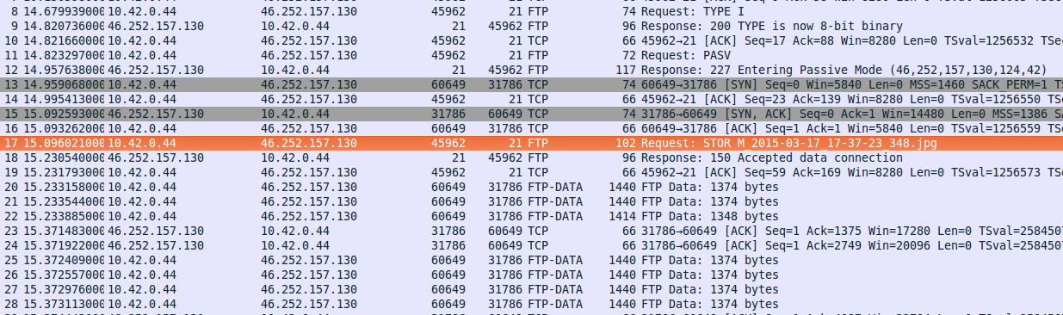
IP Camera: Privacy Issues
Video can be recovered from FTP data traffic by network eavesdropper
DNS query, HTTP headers, and ports identify a Sharx security camera
private user data

Slide 9
Ubi: Traffic Analysis
All voice-to-text traffic sent in clear over port 80
Activities sent in clear, and radio streamed over port 80
Sensor readings are synced with server in the background over port 80
Only communication with google API used HTTPS on port 443 and port 5228 (google talk)
DNS query: portal.theubi.com, www.google.com, mtalk.google.com, api.grooveshark.com

Slide 10
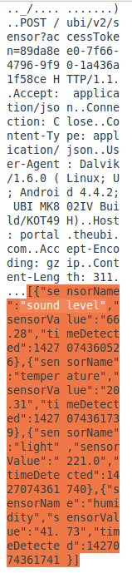
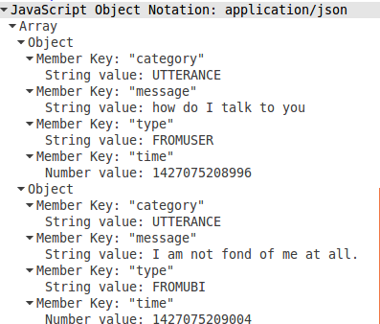
Ubi: Privacy Issues
Although HTTPS is clearly available, Ubi still uses HTTP to communicate to its portal. Eavesdropper can intercept all voice chats and sensor readings to Ubi’s main portal
Sensor values such as sound, temperature, light, humidity can identify if the user is home and currently active
Email in the clear can identify the user
DNS query, HTTP header (UA, Host) clearly identifies Ubi device
current state
current activity

Slide 11
Nest Thermostat: Traffic Analysis
All traffic to nest is HTTPS on port 443 and 9543
Uses TLSv1.2 and TLSv1.0 for all traffic
We found some incoming weather updates containing location information of the home and weather station in the clear. Nest has fixed this bug after our report.
DNS query: time.nestlabs.com, frontdoor.nest.com, log-rts01-iad01.devices.nest.net. transport01-rts04-iad01.transport.home.nest.com

Slide 12
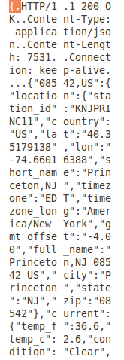
Nest: Privacy Issues
Fairly secure device: all outgoing personal traffic, including configuration settings and updates to the server, use HTTPS
*User zip code bug has been fixed
DNS query as well as the use of the unique port 9543 clearly identifies a Nest device.
user zip code*

Slide 13
Smartthings Hub: Traffic Analysis
All traffic over HTTPS on port 443 using TLS v1.2
No clear text port 80 traffic
Flows to an Amazon AWS instance running smartthings server
3-5 packets update every 10 sec in the background
DNS query: dc.connect.smartthings.com

Slide 14
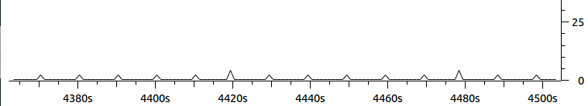
Smartthings: Privacy Issues
Very secure: No information about IoT devices attached to hub is leaked
Background updates every 10 seconds (over HTTPS) fingerprint the hub
DNS query identifies Smartthings hub, but not individual devices
fingerprintable background traffic
packets/sec
Smartthings Traffic

Slide 15
Conclusion: Be Afraid!
Very difficult to enforce security standards
Multiple manufacturers
Low capability devices
Use of non-standard protocols and ports
Difficult to maintain and patch due to low workforce and/or expertise
Who is responsible? (ISPs? Consumers? Manufacturers?)
Who is liable? Who should pay?

Slide 16
Conclusion: Be Afraid!
Very difficult to enforce security standards
Multiple manufacturers
Low capability devices
Use of non-standard protocols and ports
Difficult to maintain and patch due to low workforce and/or expertise
Who is responsible? (ISPs? Consumers? Manufacturers?)
Who is liable? Who should pay?
Can we solve this on the network? If so, how?
How much information about user behavior do devices leak to the network?
Can we offload device security to the home gateway or the cloud?

Slide 17
Thanks!

Slide 18
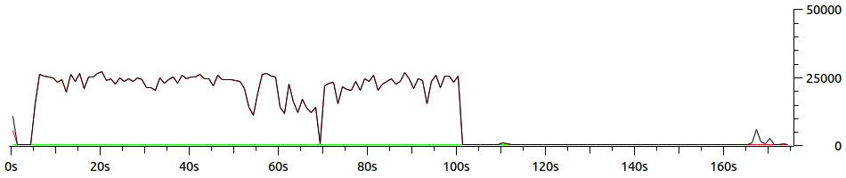
Smartthings: outlet and door sensor
t=0 to t=100: Switch outlet ON and OFF repeatedly using mobile app
>t=100: Background activity
y-axis: Bytes per 10s

Slide 19
Smartthings hub (Work in progress)
Difference in activity pattern for door sensor and smart outlet
May identify type of user activity and device category (if not the exact device) from this limited list: http://www.smartthings.com/compatible-products
Associate network pattern with activity
Eavesdrop to predict user behavior

